Slide 1

Project Title
Crafting & Compelling Website analysis, Audit and recommendations
Suvashini S

Slide 2
Agenda
Introduction
Website Audit Overview
Identified Issues
Recommendations & Best
Landing Page Design
Conclusion

Slide 3
Introduction
Project Objective :
To enhance HCL’s website performance and user experience by conducting a comprehensive audit, identifying key issues, and providing actionable recaommendations to improve design, usability, and conversion rates.
Scope :
Website Audit: Evaluated website’s UX, mobile responsiveness, SEO performance, and accessibility. Identified Issues: Focused on design inconsistencies, user engagement challenges, and technical performance gaps. Recommendations: Provided strategic suggestions for design enhancements, content optimization, and stronger calls to action (CTAs).
Landing Page Creation: Developed a new landing page design to improve user interaction and conversion outcomes.

Slide 4
Website Audit Overview
Key Areas Evaluated:
User Experience (UX): Assessed the website’s navigation, layout, and overall ease of use.
Mobile Responsiveness: Tested website performance across different devices and screen sizes.
SEO Performance: Reviewed on-page SEO elements, including meta tags, keyword usage, and page speed.
Accessibility: Evaluated the website’s compliance with accessibility standards to ensure inclusivity.

Slide 5
Identification of Issues
Poor Mobile Optimization: The website is not fully responsive, leading to a subpar experience on mobile devices.
Unclear Call-to-Actions (CTAs): CTAs are not prominent or persuasive enough to drive user engagement.
Slow Page Load Times: Pages take too long to load, negatively affecting user retention and SEO ranking.
Inconsistent Design & Branding: Visual elements and branding are not cohesive, leading to a disjointed user experience.
Content Gaps: Key information is either missing or not clearly presented, affecting user understanding and conversions.

Slide 6
Recommendations & Best Practices
Improve Mobile Responsiveness: Optimize the website for a seamless experience across all devices and screen sizes.
Enhance Call-to-Actions (CTAs): Make CTAs more prominent, clear, and action-oriented to drive conversions.
Boost Page Speed: Compress images, enable browser caching, and reduce server response time to improve loading speed.
Strengthen Visual Consistency: Ensure cohesive branding and design elements across the website for a unified look and feel.
Content Optimization: Refine content for clarity, SEO, and user engagement by improving structure, keyword placement, and readability.
Accessibility Enhancements: Implement accessibility best practices to make the website more inclusive

Slide 7

Landing Page Design

Slide 8


Slide 9
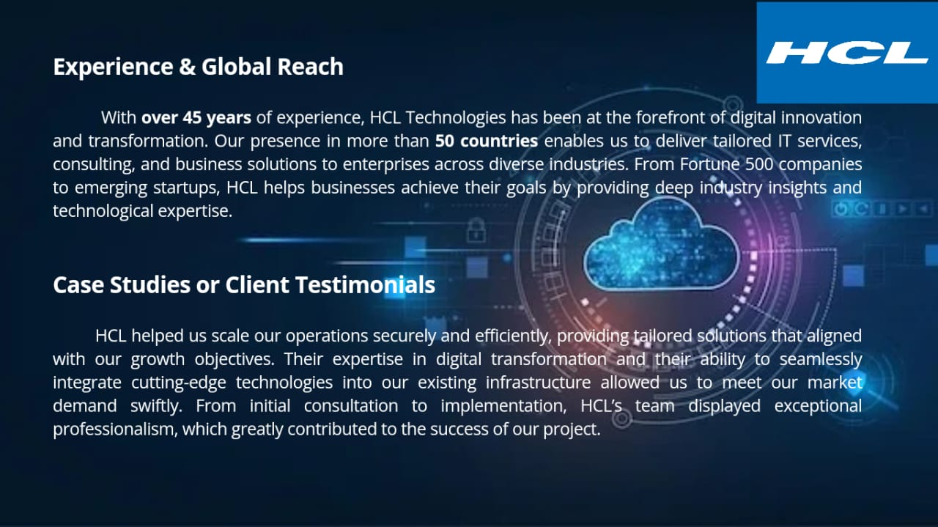

Slide 10
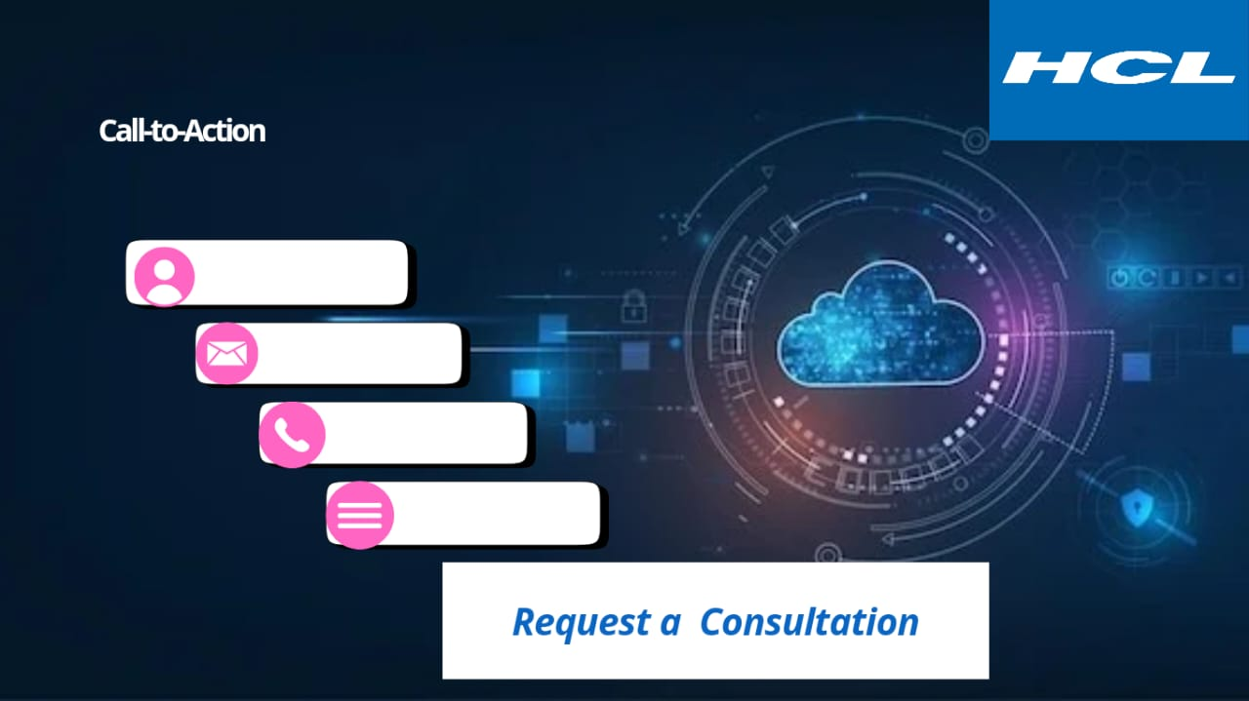

Slide 11
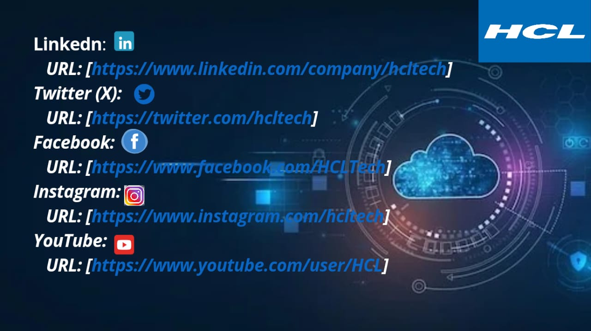

Slide 12
Conclusion
Summary of Findings: The website audit identified key issues, including poor mobile optimization, slow load times, unclear CTAs, and inconsistent design, all of which impact user experience and conversions.
Recommendations: Implementing design improvements, optimizing content, enhancing mobile responsiveness, and improving page speed will significantly boost user engagement and website performance.
Next Steps: Prioritize the recommended changes and launch the newly designed landing page to enhance HCL’s digital presence and drive conversions.

